Slide 1

Lecture 13 and 14
Fundamentals and Applications (CSO201A)
Dr. Srinivas Dharavath
Assistant Professor
Department of Chemistry
Indian Institute of Technology, Kanpur
Kanpur- 208016
E-mail: srinivasd@iitk.ac.in

Slide 2
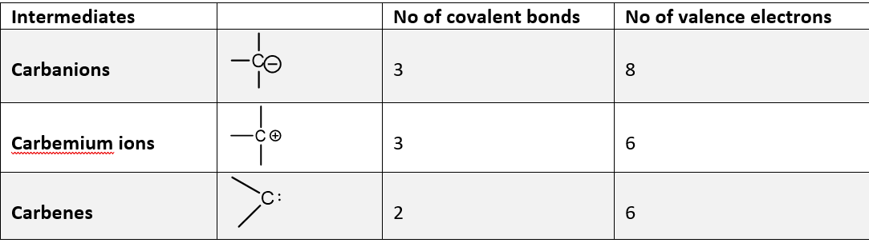


Carbenes
Structure and Geometry of Carbenes
Carbene chemistry has experienced tremendous growth and broad interest in the past few decades. The investigation of divalent carbon intermediates proved to be rewarding from a theoretical as well as an experimental point of view. The long-lasting fascination of the carbene concept for organic chemists appears to have emotional rather than empirical grounds. Because they do not respect the ‘‘octet rule,’’ carbenes have long been considered as fleeting intermediates in molecular chemistry. These fascinating species are involved in many reactions of high synthetic interest. In below table presents the formal relationship of carbene to other simple carbon intermediates. With most of the intermediates mentioned in below table, the existence of moderately stable species (e.g., triarylmethyl derivatives) has provided a basis for the investigation of transient analogs.

Slide 3
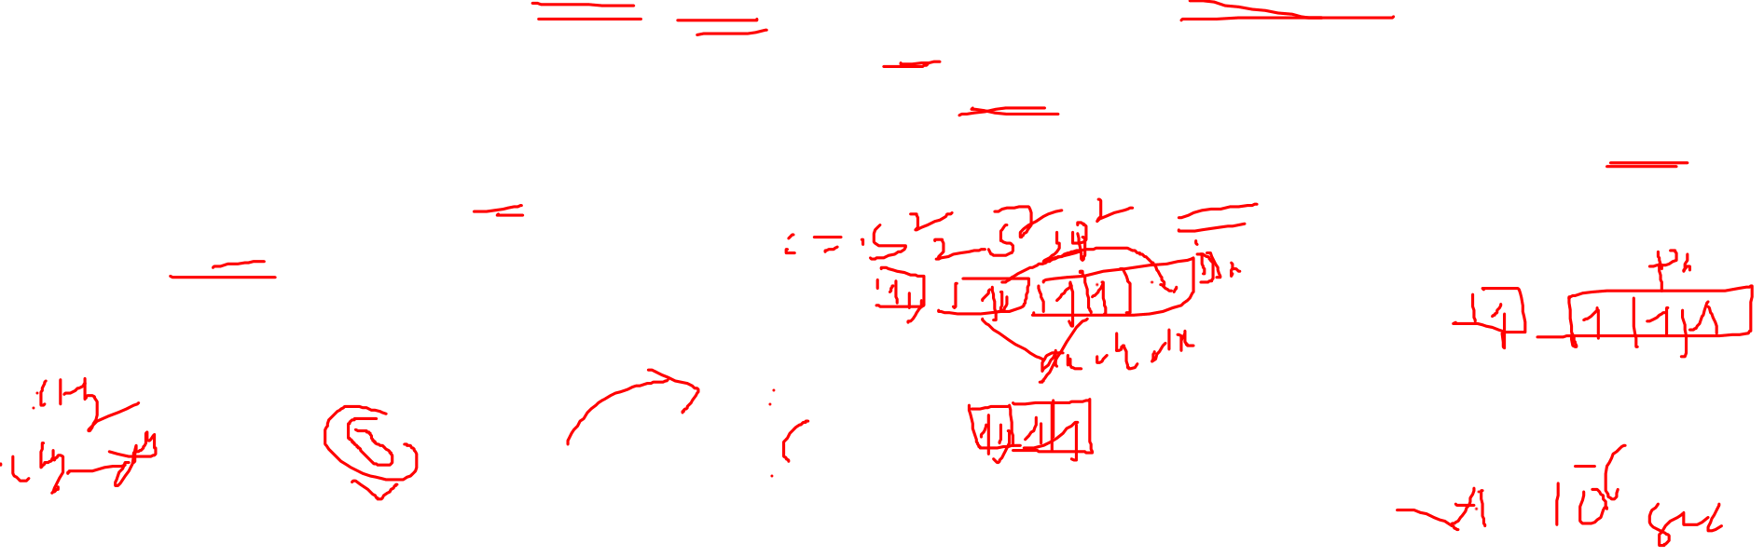
Carbenes
Carbenes are classified as either singlets or triplets depending upon their electronic structure. The nature of the ground state depends on the relative energies of the two nonbonding orbitals. If the two orbitals are equivalent, according to Hund’s rule the electron should be assigned to different orbitals with parallel spins. On the other hand, if the two available orbitals are not degenerate the two electrons would probably occupy the lower of the two orbitals with consequent spin pairing. Singlet carbenes have a pair of electrons in the highest occupied molecular orbital (HOMO) σ, the pπ orbital being vacant with a sp2 hybrid structure.
As a result, singlet carbenes exhibit both nucleophilic and electrophilic character. Triplet carbenes have two unpaired electrons. They may be either sp2 hybrid or linear sp hybrid. Most carbenes have a nonlinear triplet ground state, with the exception of carbenes with nitrogen, oxygen, sulfur atoms, and dihalo carbenes. Above figure shows some representations for different electronic states that could be proposed for methylene. Depending on whether the nonbonding electrons are of the same or opposite spin, they are triplet or singlet species.

Slide 4
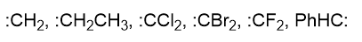

Carbenes
As a result, singlet carbenes exhibit both nucleophilic and electrophilic character. Triplet carbenes have two unpaired electrons. They may be either sp2 hybrid or linear sp hybrid. Most carbenes have a nonlinear triplet ground state, with the exception of carbenes with nitrogen, oxygen, sulfur atoms, and dihalo carbenes. Above figure shows some representations for different electronic states that could be proposed for methylene. Depending on whether the nonbonding electrons are of the same or opposite spin, they are triplet or singlet species.

Slide 5

Generation of carbenes
α elimination of chloroform with base
α elimination means the eliminations in which both the proton and the leaving group are located on the same atom.
A strong base removes an acidic proton adjacent to an electron withdrawing group to give a carbanion.
Loss of a leaving group from the carbanion creates a carbene.
One of the best known elimination reactions occurs when chloroform is treated with base, forming a dichlorocarbene.
The more common dehydrogenations (to form alkenes)are called beta(β) eliminations because the hydrogen and the halogen are lost from adjacent carbon atoms.

Slide 6

Generation of carbenes
Thermal decomposition of diazo compounds
From tosyl hydrazones
Much more widely used carbene precursors are tosylhydrazones, which are readily prepared from aldehydes or ketones by reaction with 4-toluenesulfonyl hydrazide. Tosylhydrazones produce transient diazo compounds by base-catalyzed elimination of toluenesulfinate. The diazo compound is not normally isolated, and decomposes to the carbene on heating. The whole process is known as the Bamford–Stevens reaction.

Slide 7

Generation of carbenes
Simmons–Smith Reaction
Reactions of Carbenes
Carbenes mainly gives four types of reaction.
Addition reaction.
Alpha-insertion.
Rearrangement reaction.
Reaction with Nucleophiles.

Slide 8

Addition Reaction

Slide 9
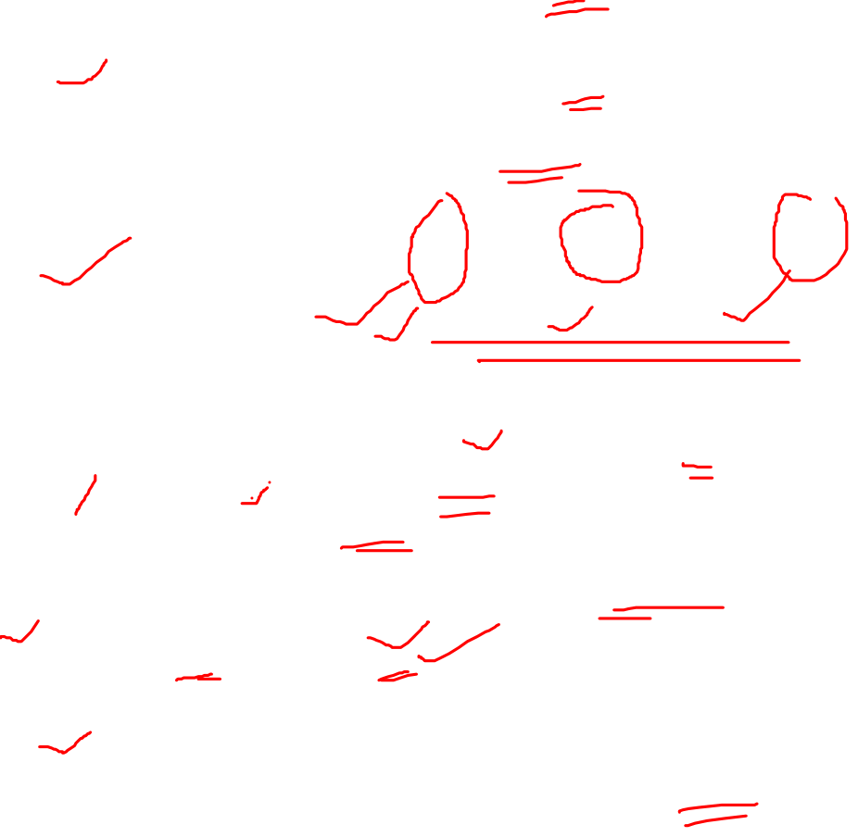
Insertion Reaction and Rearrangement Reaction

Slide 10
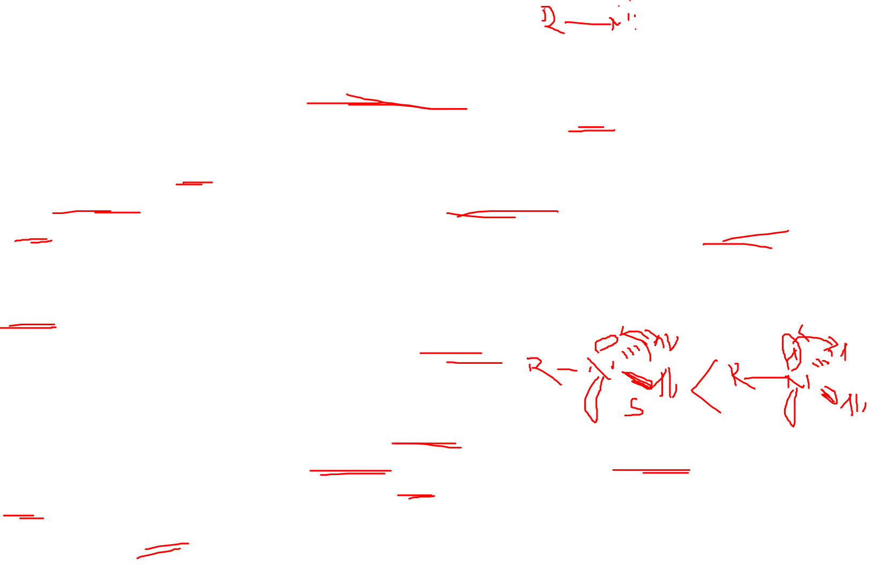
Nitrene Intermediate
The diatomic molecule NH and its derivatives N–Rare usually referred to as nitrenes; they are neutral reactive intermediates of increasing importance in both organic and inorganic chemistry. Nitrenes are molecular entities, which are usually formed thermally or photochemically from hydrazoic acid or organic azides. The name nitrene stands for the electron-deficient, electroneutral, monovalent, highly reactive molecule NH and its derivatives, which are formed by substitution of the hydrogen in NH. Thus, nitrenes are the nitrogen analogs of carbenes in which nitrogen has six electrons in its valence shell, and is therefore considered as an electrophile. There are four nonbonded electrons (two being the ‘‘normal’’ lone pair associated with nitrogen) indicated by the four dots in the drawn structure. Such univalent short-lived species were first suggested by Tiemann in 1891 as intermediates in the Lossen rearrangement, later on by Stieglitz in 1896 in the Curtius rearrangement, and were also adopted by Curtius to explain various reactions of azides. Kinetics of the cleavage of azides, spectroscopic data, and electron spin resonance (ESR) measurements constitute proof for a biradical nature of the nitrenes studied.
Structure and Reactivity
Nitrenes are unusual molecular structures that exhibit high reactivities. Although they are isoelectronic with carbenes and can be generated and detected in a similar manner, they usually exhibit different reactivities. The chemistry of nitrenes closely parallels to that of carbenes in virtually all aspects. Like carbenes there is the possibility of two spin states for nitrenes, depending on whether the two nonbonding electrons (the normal nitrogen lone pair remains paired) have their spins paired or parallel.

Slide 11

Generation of Nitrenes
Nitrenes are so reactive they are not isolated but, instead, are generated in situ, that is, formed as reactive intermediates during the course of a reaction. There are two common ways to generate nitrenes: (i) from azides by thermolysis or photolysis, with expulsion of nitrogen gas (this method is analogous to the formation of carbenes from diazo compounds) and (ii) from isocyanates, with expulsion of carbon monoxide.

Slide 12

Generation of Nitrenes
Other methods of generation of nitrenes include thermal and photochemical decomposition of nitrogen-containing precursors. These method is analogous to the formation of carbenes from ketenes.

Slide 13
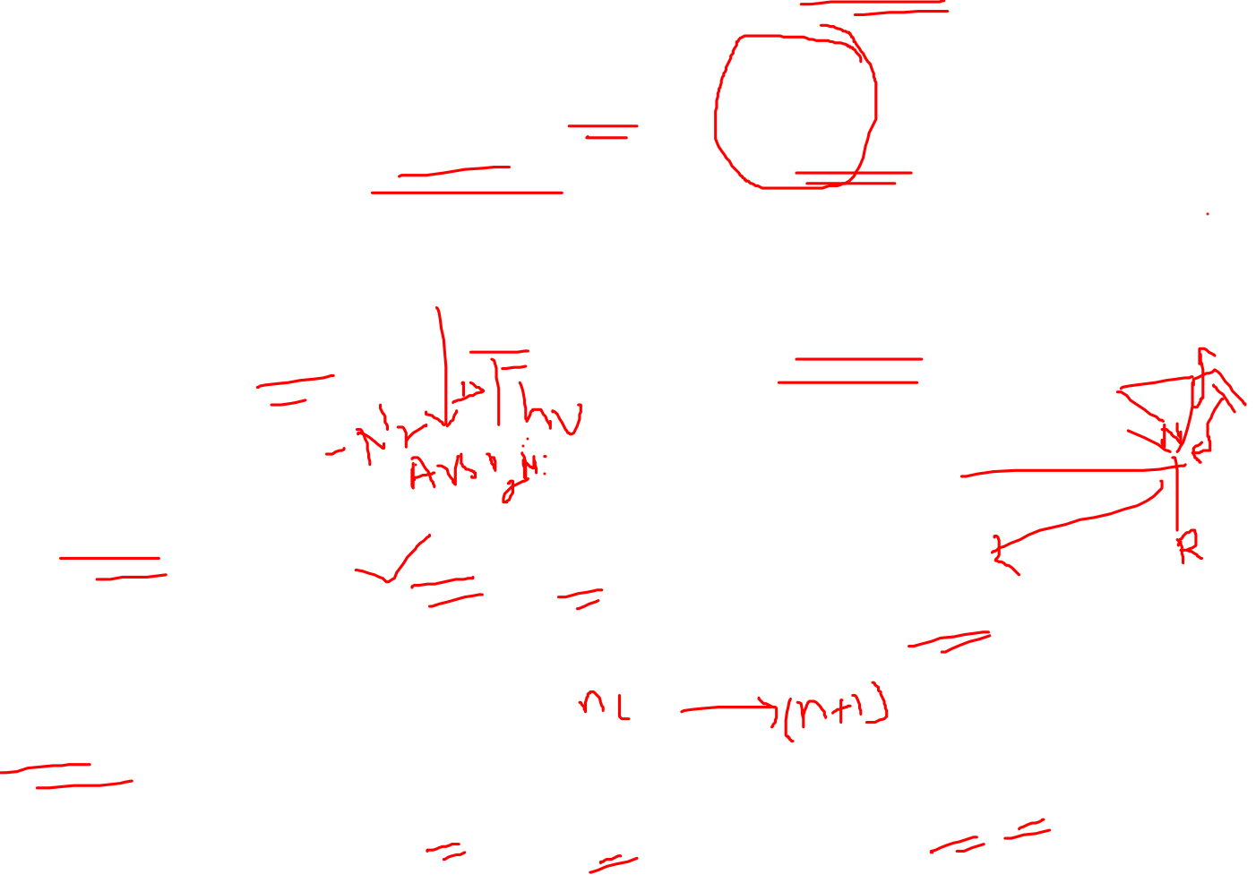
Cycloaddition to Alkenes
Cycloaddition to 1,3-Dienes
Cycloaddition to Arenes

Slide 14
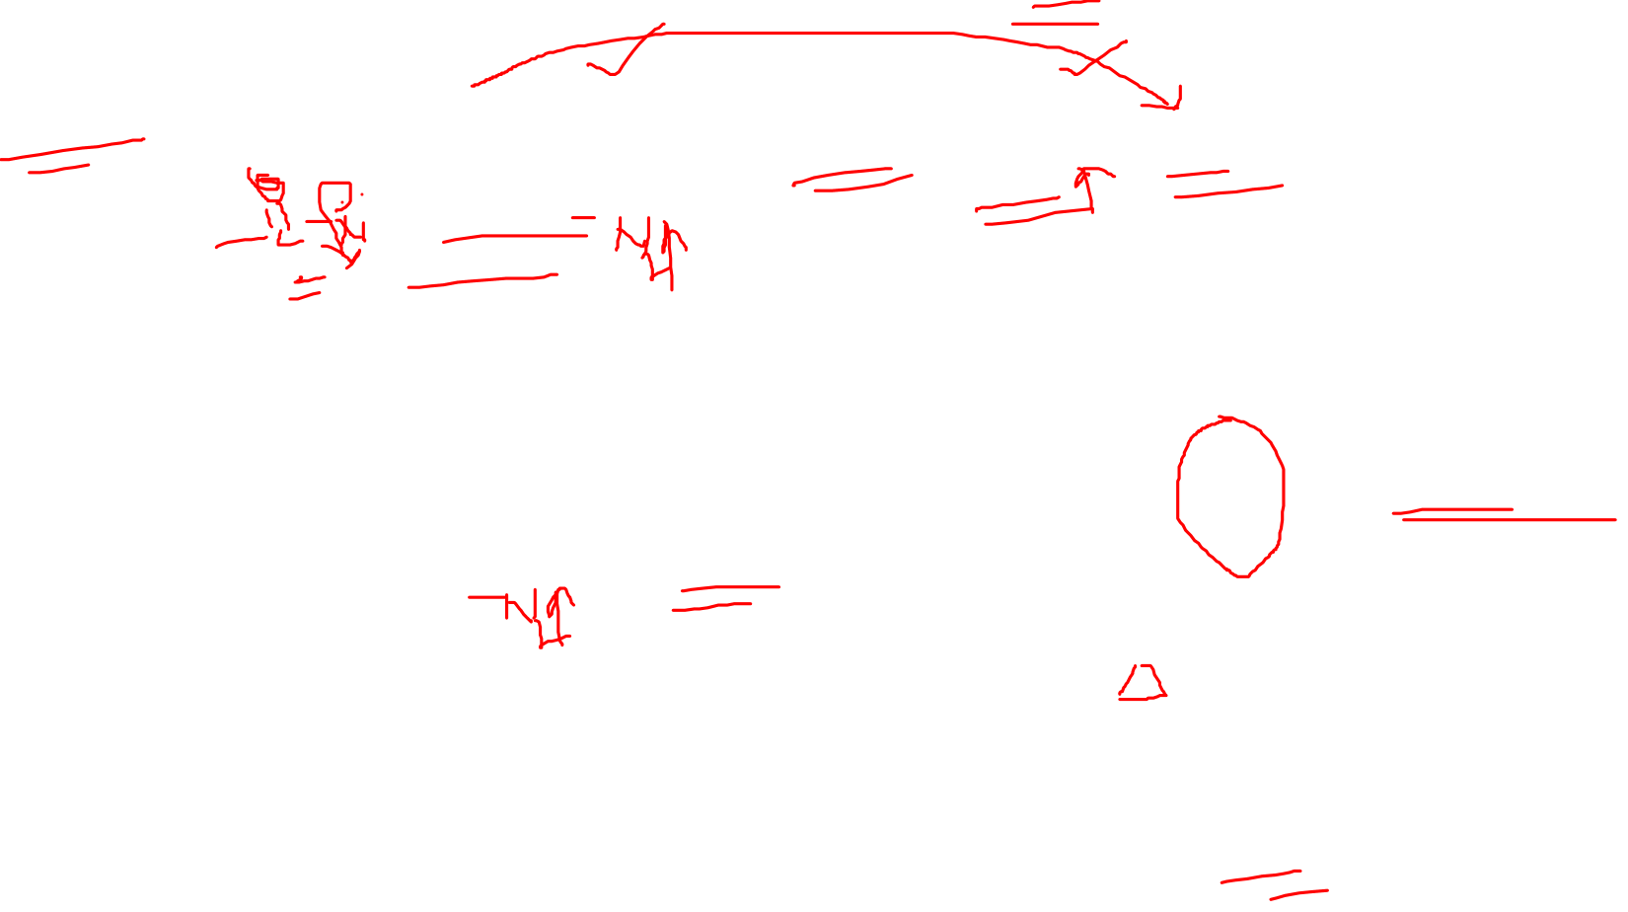
Rearrangement of Nitrenes
Curtius rearrangement

Slide 15

Rearrangement of Nitrenes
Hofmann rearrangement
Lossen rearrangement

Slide 16

Benzyne
Arynes are highly reactive species, which have attracted much attention because of their intriguing structure and properties. Various methods of aryne generation have been developed so far enabling the straightforward construction of diverse aromatic molecules with successful application to several total syntheses of complex natural products. Arynes and heteroarynes are derived formally by the removal of two adjacent (ortho-) substituents from aromatic or heteroaromatic rings, respectively, leaving behind two electrons to be distributed between two orbitals. Although in most cases the substituents are ortho to one another, this is not a prerequisite and meta- and para-arynes are also possible intermediates.
Structure and Reactivity
ortho-Benzyne is usually represented as a singlet molecule with a carbon–carbon triple bond.
This strained π-bond is formed by lateral overlap of the two orbitals in the plane of the ring.
This external π bond is very weak, which is why benzyne is a very unstable and highly reactive intermediate.
The carbon–carbon triple bond length in the range 1.25–1.34 ˚A.
ortho-benzyne has IR absorption of 2085 cm⁻¹ .

Slide 17

Generation of Benzyne

Slide 18

Reactions of Benzyne
Dimerization
Nucleophilic Addition to Arynes

Slide 19

Reactions of Benzyne
Regiochemistry of the addition of nucleophile to the triple bond

Slide 20

Reactions of Benzyne
Cycloaddition Reactions of Arynes (Diels–Alder Reaction)

Slide 21

Reactions of Benzyne

Slide 22

REFERENCES
Carey, Francis A.; Sundberg, Richard J.; (1984). Advanced Organic Chemistry Part A Structure and Mechanisms (2nd ed.). New York N.Y.: Plenum Press.
March Jerry; (1885). Advanced Organic Chemistry reactions, mechanisms and structure (3rd ed.). New York: John Wiley & Sons, inc.
GILCHRIST, T. L. (1966). CARBENES NITRENES AND ARYNES. SPRINGER US.
MOSS, ROBERT A.; PLATZ, MATTHEW S.; JONES, JR., MAITLAND (2004). REACTIVE INTERMEDIATE CHEMISTRY. HOBOKEN, N.J.: WILEY-INTERSCIENCE.
Maya Shankar Singh, REACTIVE INTERMEDIATES IN ORGANIC CHEMISTRY

